Slide 1
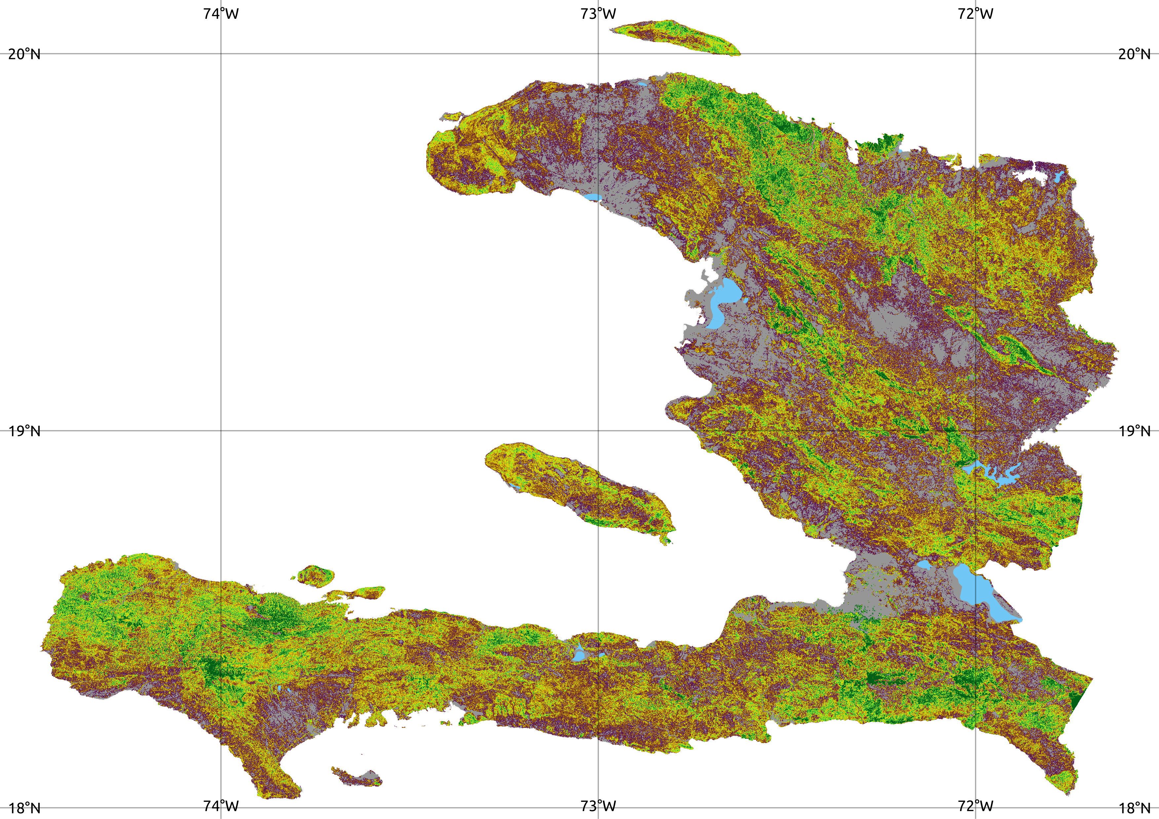
Mapping above-ground biomass, 2019
Emily Sturdivant, M.Sc.
Universidad Nacional Autónoma de México
27 May, 2021
Notes:
I’m going to talk about creating the biomass layer for the model.

Slide 2
Mapping above-ground biomass, 2019
Objectives
Create island-wide high-resolution map of above-ground biomass.
Estimate map accuracy.
Quantify above-ground biomass stock.
Notes:
We had three main objectives: to create a high-resolution map of biomass for the island of Hispaniola; to estimate the map accuracy; and to use the result to quantify the above-ground biomass stock.

Slide 3
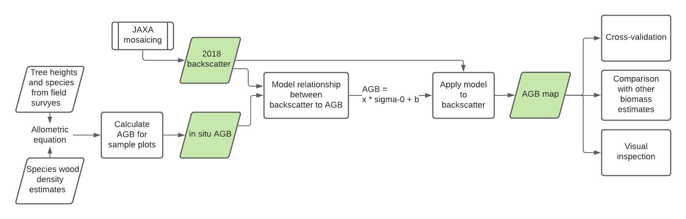
Biomass mapping
We map above-ground biomass (AGB) by calibrating backscatter imagery to field measurements.
Ground data from field surveys
2. Calibrate backscatter
3. Apply model to produce AGB map
4. Validate map
World Bank – Charcoal in Haiti
Notes:
This is the overall process used to create the biomass map. First we collected ground data in Haiti in 2019. We used these field measurements of biomass to calibrate satellite radar data and produce a map of above-ground biomass for 25 x 25 m pixels for the entire island of Hispaniola. Today I’ll focus on the Haiti portion of the map.

Slide 4
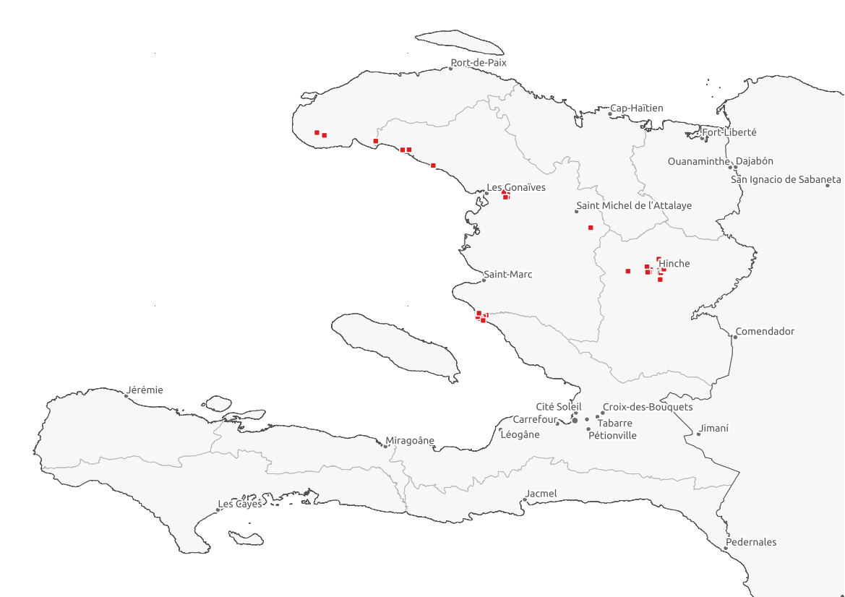
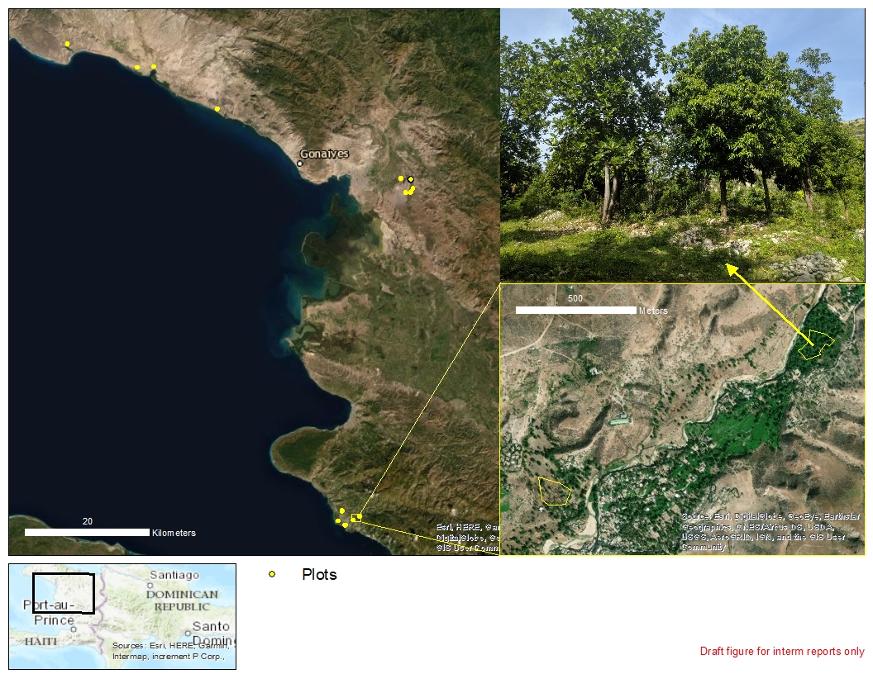
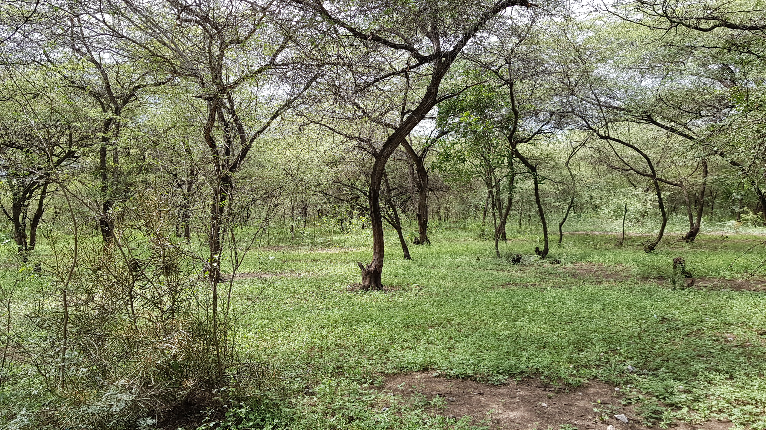
Field surveys
36 plots with a range of vegetation composition.
Measured tree diameter, height, and species
Plot areas from 0.3–2.5 ha.
World Bank – Charcoal in Haiti
Notes:
In September and October of 2019, the team travelled to 36 sites as shown on the map. The sites were chosen to capture a range of biomass conditions. They varied in area from 0.3 to 2.5 ha. The photos show examples.

Slide 5
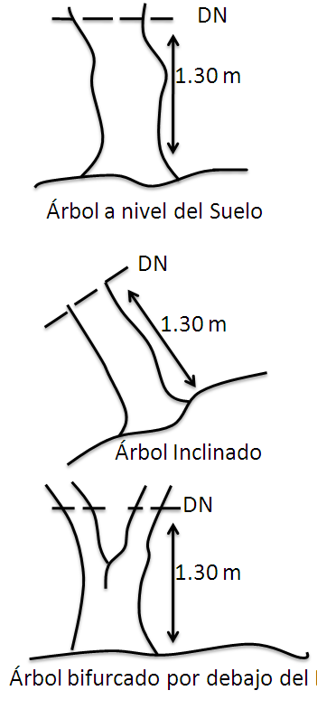
Field surveys
36 plots with a range of vegetation composition.
Measured tree diameter, height, and species
Plot areas from 0.3–2.5 ha.
World Bank – Charcoal in Haiti
Notes:
For every tree in the survey plot, they recorded species and diameter. They measured height for about 45% of the trees.

Slide 6
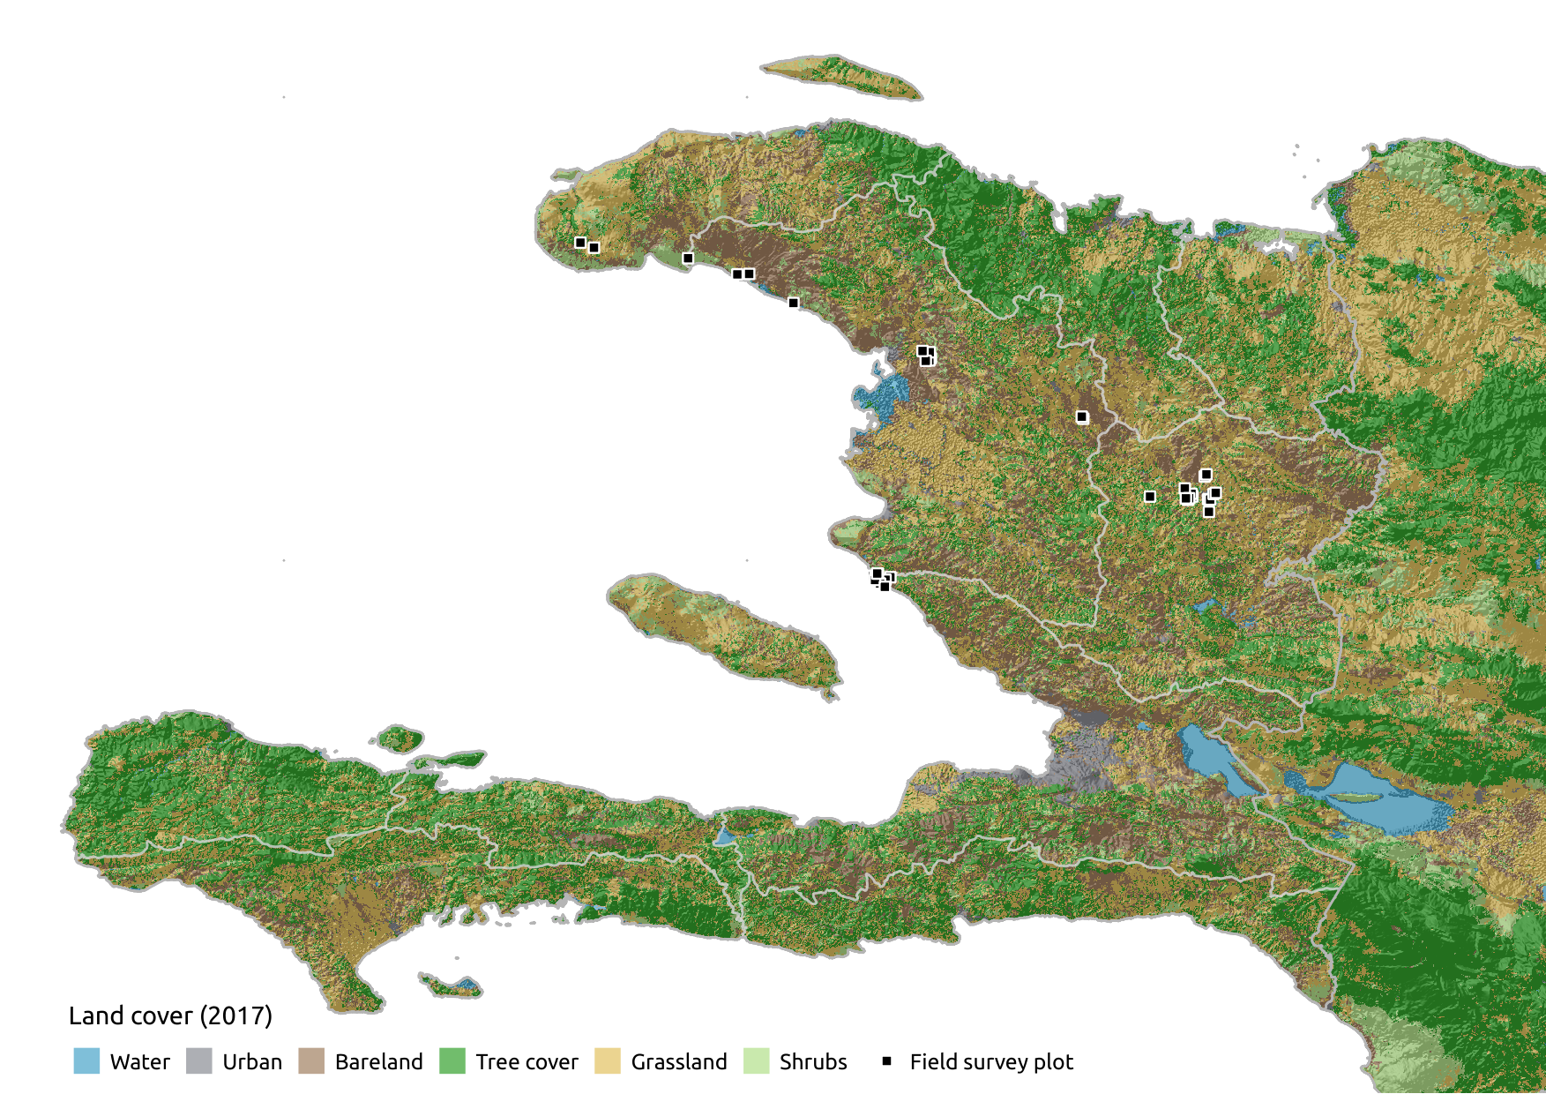
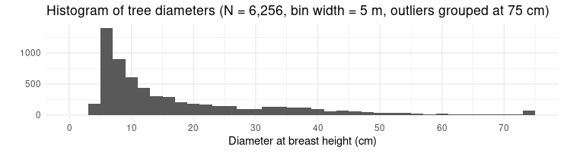
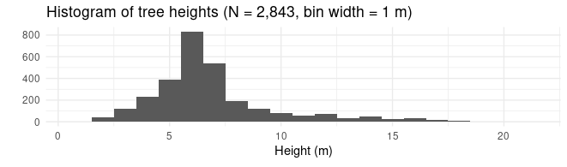
Field surveys
36 plots with a range of vegetation composition.
Measured tree diameter, height, and species.
Plot areas from 0.3–2.5 ha.
World Bank – Charcoal in Haiti
Notes:
Here you can see the locations of the plots in relation to landcover (the map presented by Richard). The collection of trees surveyed had an average diameter of 18 cm, median of 11 cm (6,256 total stems recorded, does not include stems with diameter <5 cm). The trees had an average height of 7 m.

Slide 7
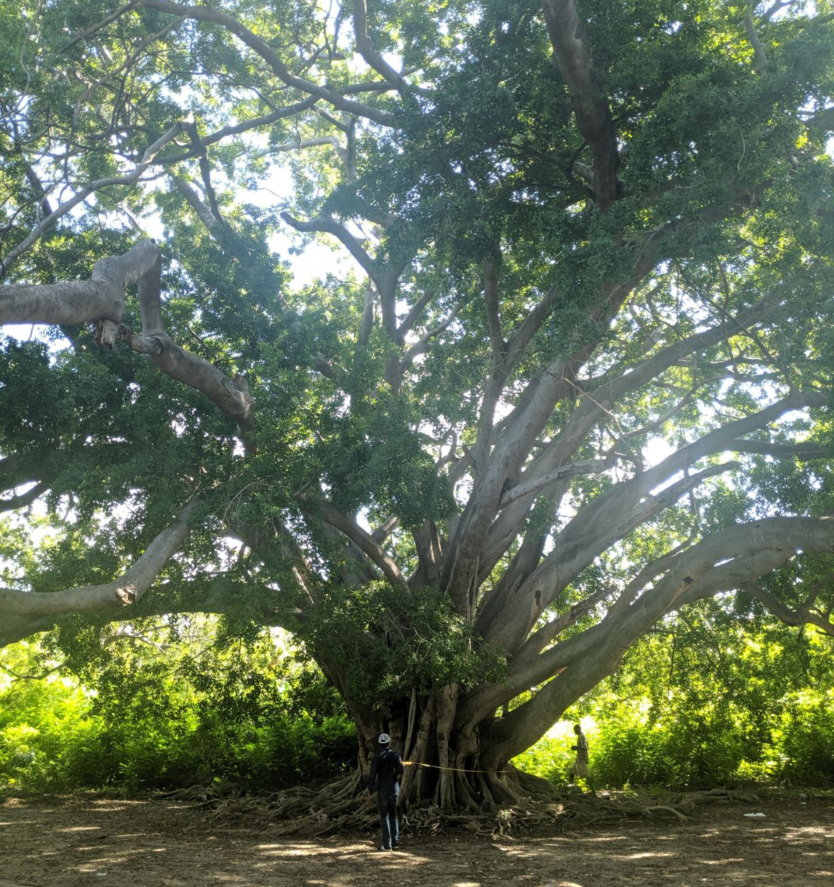
Field surveys
36 plots with a range of vegetation composition.
Measured tree diameter, height, and species.
Plot areas from 0.3–2.5 ha.
World Bank – Charcoal in Haiti
Notes:
This Figuier tree in Deluger was by far the biggest tree surveyed. It has a diameter of 362 cm and height of 19.4 m.

Slide 8
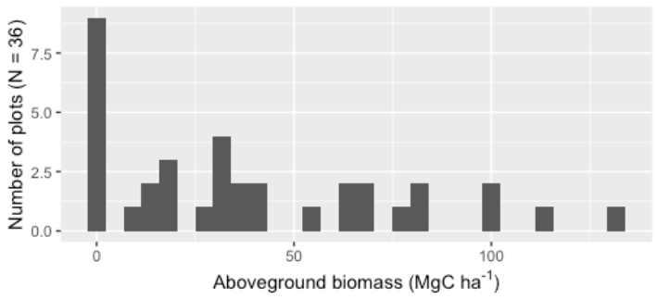
Calculating plot biomass
Pan-tropical allometric equation from Chave et al. (2014; Eq. 4)
Diameter at breast height (DBH) – measured for every stem at 1.3 m from ground
Height – interpolated from local DBH-height relationship for 65% of observations
Wood density – species wood density from literature
World Bank – Charcoal in Haiti
Notes:
Back in Mexico, we used the field measurements to calculate above-ground biomass using the pan-tropical equation by Chave et al. 2014. We obtained the wood density for each species based on the literature (Bwa Yo trees of Haiti by Joel Timyan and the Global Wood Density Database as originally published by Amy Zanne). This produces the biomass of each tree based on its diameter, height, and wood density. We summed the tree biomasses to calculate the AGB for each plot.

Slide 9
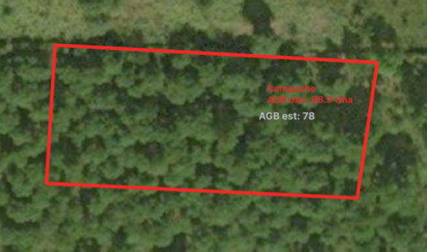
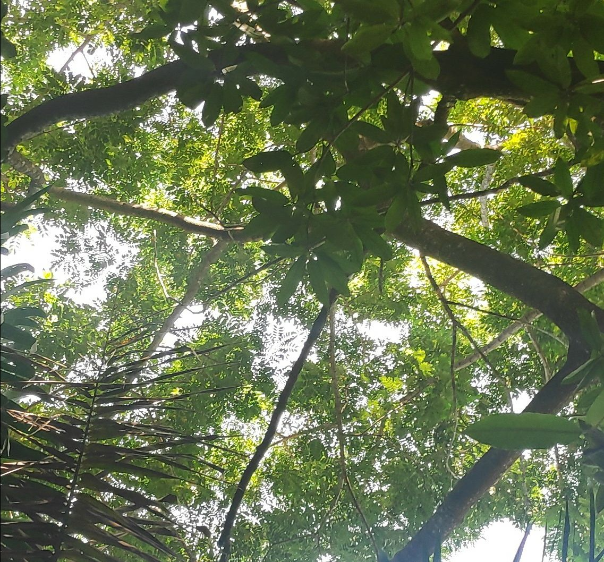
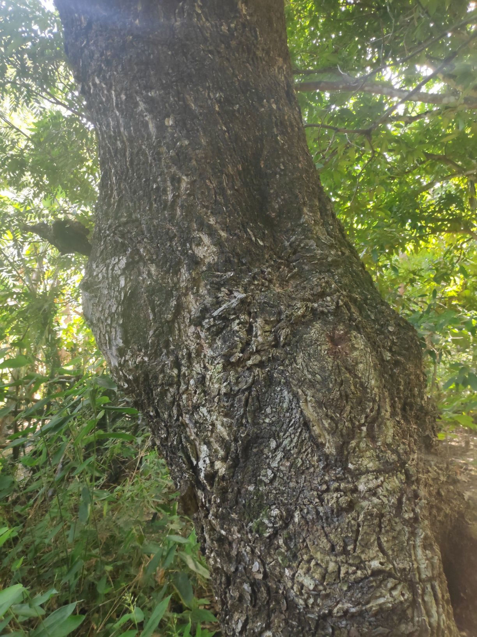
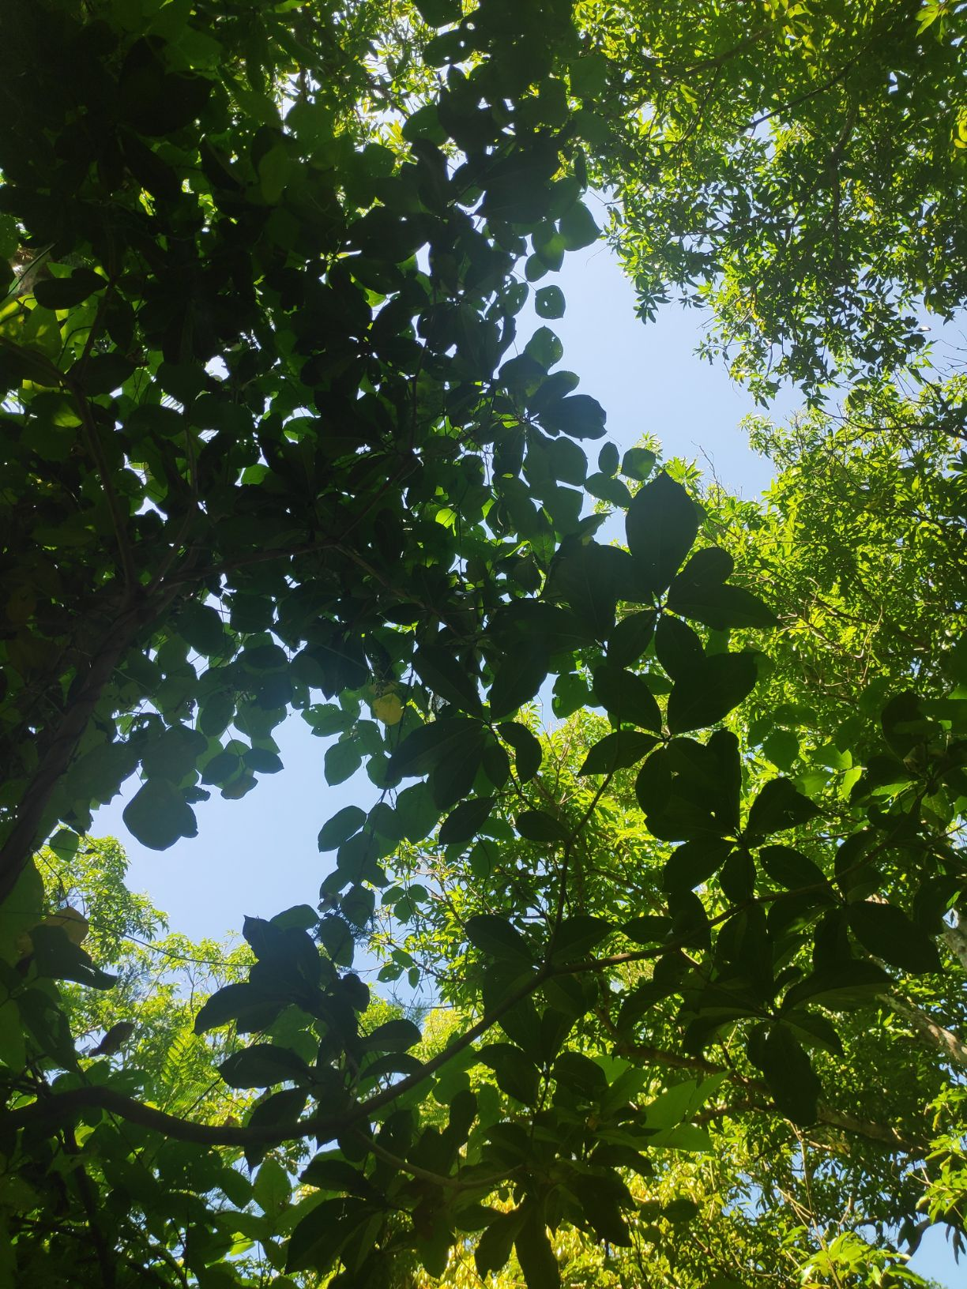
AGB reference values
This plot in Campeche has about 100 Mg/ha AGB.
Many large trees, closely spaced.
World Bank – Charcoal in Haiti
Notes:
Now, what do these biomass values actually mean?
I want to show you some images from the survey plots along with their biomass measurements to give you an idea.
This plot in Campeche has one of the highest biomass values of the surveyed plots, 100 Mg/ha. It has many large trees spaced closely together.

Slide 10
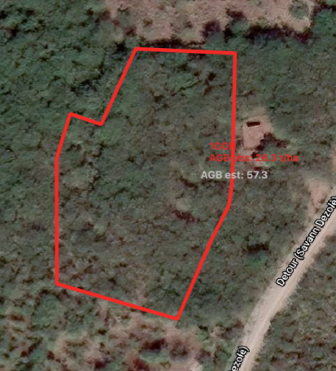
AGB reference values
Casey Ryan suggests that AGB > 20 Mg/ha could be considered tree cover.
This plot in Gonaives has 26 Mg/ha AGB.
Very small trees/shrubs.
World Bank – Charcoal in Haiti
Notes:
This plot in Gonaives has 26 Mg/ha AGB. As you can see, it has widely spaced trees with thin trunks and a low canopy. It appears to have consistent tree cover, but it has very low biomass.

Slide 11
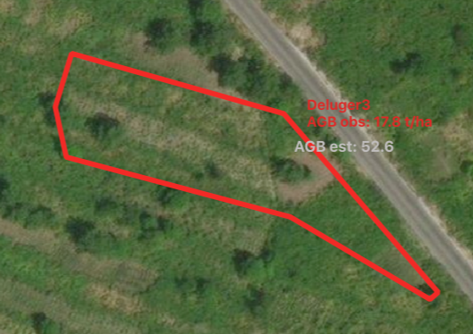
AGB reference values
This plot in Deluger has 18 Mg/ha AGB.
35 trees recorded.
World Bank – Charcoal in Haiti
Notes:
This plot in Deluger has 18 Mg/ha. It appears to be mostly bare land with scattered trees. The survey recorded 35 trees over an area of ___ ha.

Slide 12
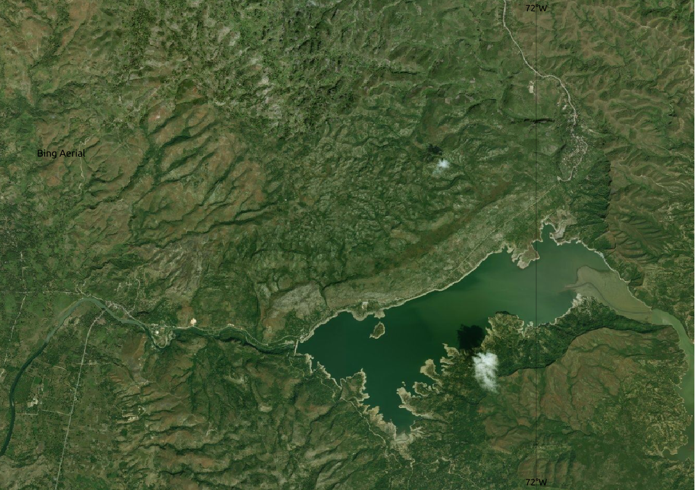
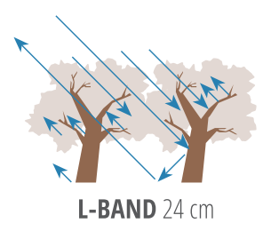
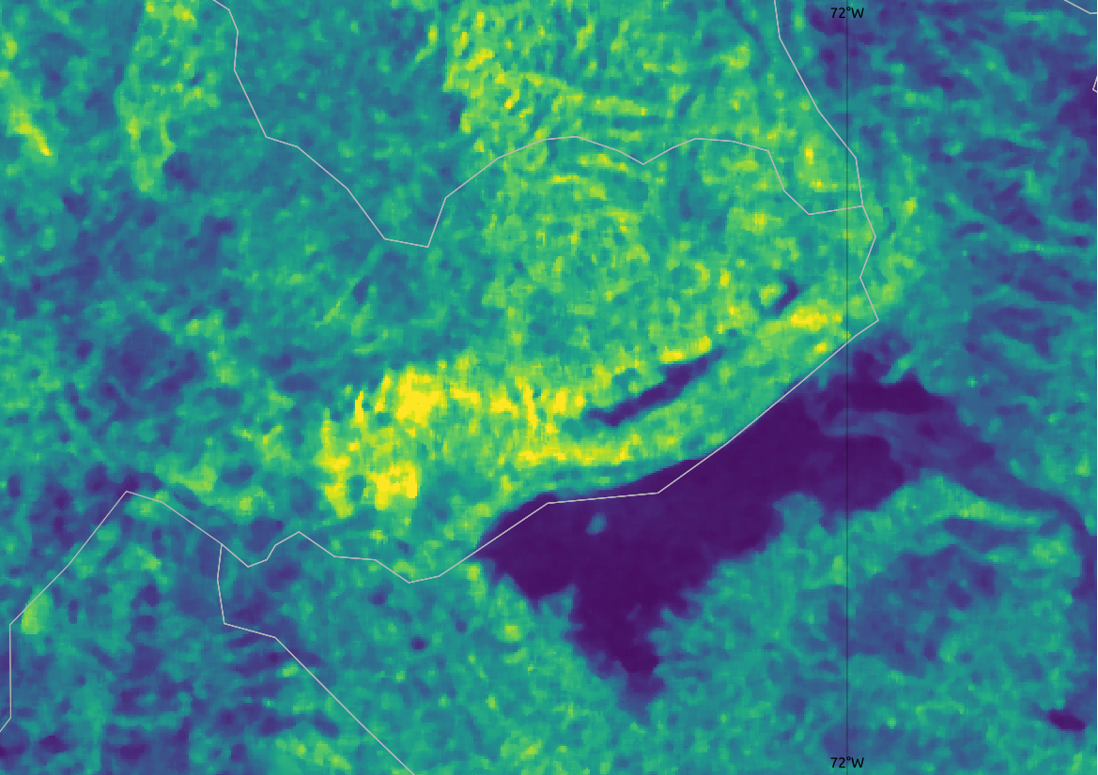
Radar data
Lac de Péligre
Radar data (“backscatter”) is sensitive to structure. The L-band wavelength reflects off tree trunks and branches. It mostly ignores foliage. Thus we see higher values in areas with more trees.
PALSAR mosaic* from JAXA
L-band HV cross-polarized
Resolution: 25 m
Year: 2019
Orthorectified and slope-corrected
De-noising filter: 5x5 median
*Shimada, M., & Ohtaki, T. (2010). Generating Large-Scale High-Quality SAR Mosaic Datasets: Application to PALSAR Data for Global Monitoring.
Right: Figure 5.10 in Saatchi, S. (2019). The SAR Handbook. Comprehensive Methodologies for Forest Monitoring and Biomass Estimation.
Bing aerial imagery
PALSAR mosaic
World Bank – Charcoal in Haiti
Notes:
Now I’ll talk about how we use these biomass measurements from 36 sites to create a map of biomass for the entire island.
We are able to use radar imagery to “detect” biomass. The long wave-lengths of radar (especially around 24 cm wavelengths) ignore leaves and clouds and reflect off structures, such as tree trunks and thick branches. The radar reflectance values are called backscatter, which can be viewed as images. Thus, the backscatter images are brighter in areas with more trees and darker in flat tree-less areas as we can see in the example in the bottom right (yellow is greater backscatter).
The data we use for this project are from the Japanese Aerospace Exploration Agency. They assemble the best images from their PALSAR satellite into an annual mosaic, which is orthorectified and slope-corrected with 25 m pixel resolution. We use the 2019 annual mosaic and additionally apply a median filter to reduce noisiness in the image.

Slide 13
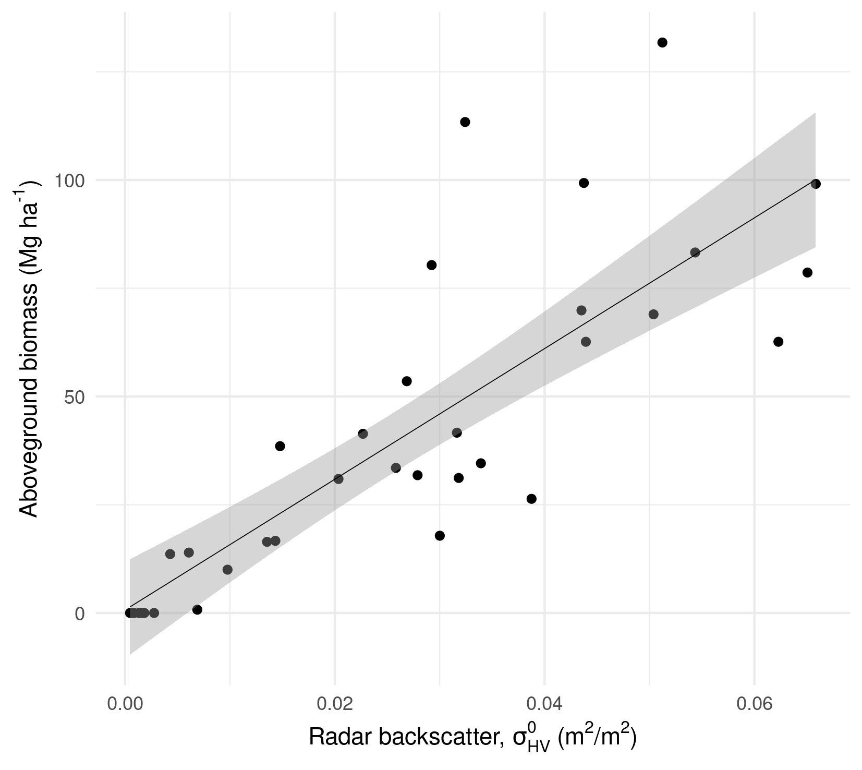
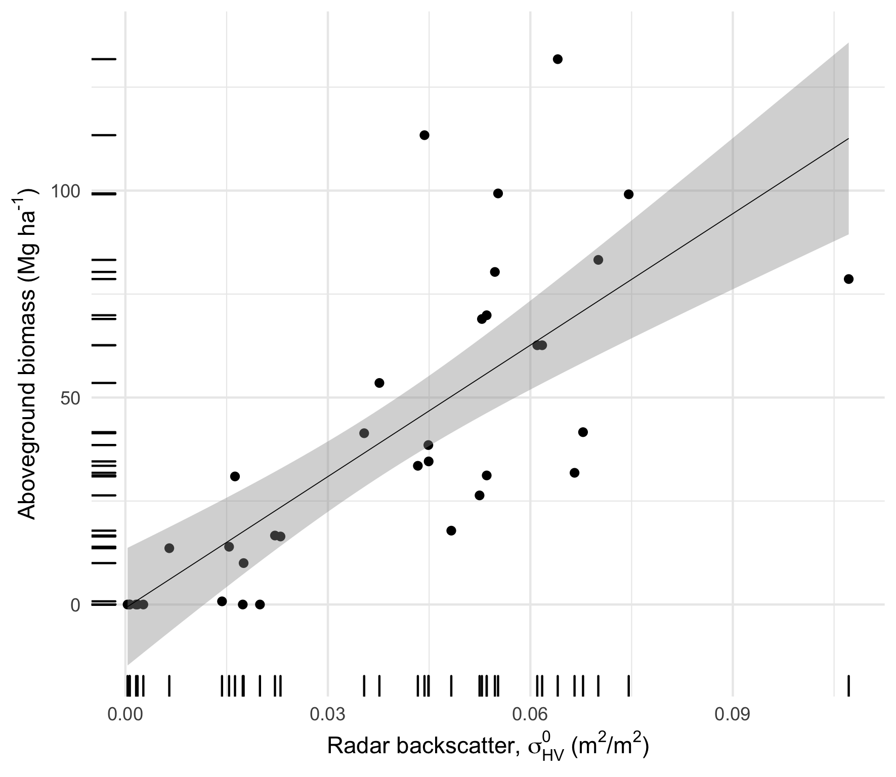
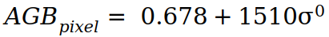
Calibrate backscatter to AGB
OLS linear regression relating backscatter (σ⁰) to plot AGB
Model:
RMSE: 19.8 ± 6.9 Mg/ha
Validation bias: 6.2 ± 4.5 Mg/ha
World Bank – Charcoal in Haiti
Notes:
To calibrate the backscatter to biomass, we first extract the mean backscatter value at the locations of the survey plots. Then we fit a linear regression to relate the backscatter to the real-world biomass values. This graph shows the final linear model. In the graph, backscatter values are on the x-axis. They are in so-called “natural units.” The y-axis shows the in situ above-ground biomass value. Each point indicates a survey plot.
We perform a linear regression and a robust cross-validation to calculate the independent error. Our model has a root mean squared error of about 20 Mg/ha and a bias of about 6 Mg/ha AGB.

Slide 14
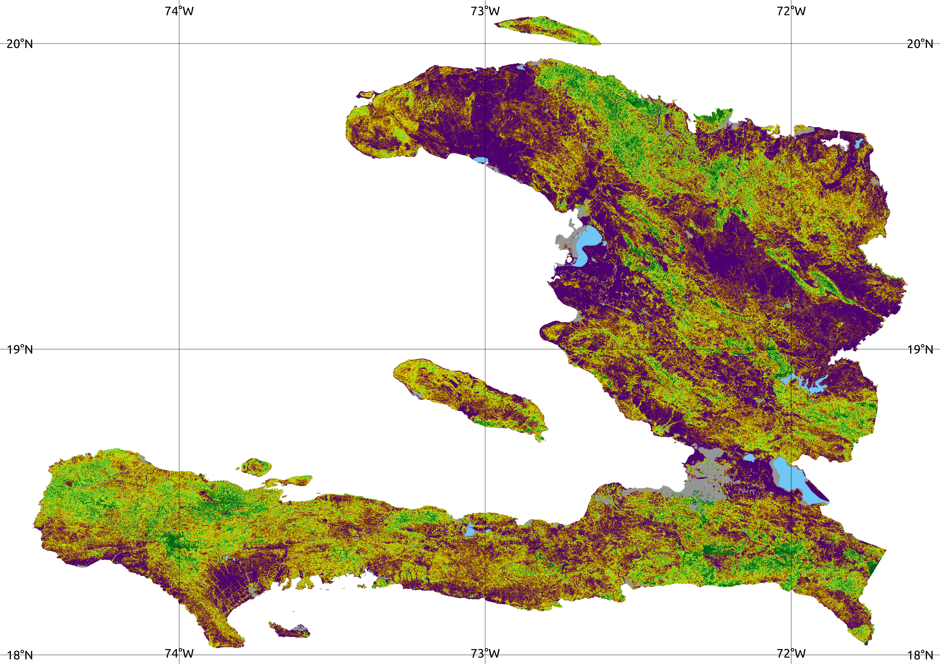
Map biomass (AGB)
Post-processing:
Set high-biomass saturation point at 300 Mg/ha.
Mask out water and urban areas based on 2017 land cover map.
100 Mg/ha
60
20
World Bank – Charcoal in Haiti
Notes:
Next, we apply the linear model to every pixel in the backscatter image to produce the map displayed. We conduct some additional post-processing steps to clean the result: we establish 300 Mg/ha as the highest biomass value possible. Any pixels with values greater than 300 are set to 300. We also remove urban and water areas based on Richard’s 2017 land cover map. Urban areas often falsely indicate high biomass because buildings have a similar backscatter signature as trees and water can have confusing backscatter signals.

Slide 15
AGB >20 Mg/ha
The map is colored only where AGB exceeds 20 Mg/ha.
Ryan et al. use a threshold of 20 Mg/ha to classify tree cover.
100 Mg/ha
60
20
World Bank – Charcoal in Haiti
Notes:
Some researchers suggest removing pixels with values less than 20 Mg/ha. These are areas without tree cover so variations in backscatter are likely not reflective of changes in biomass.

Slide 16
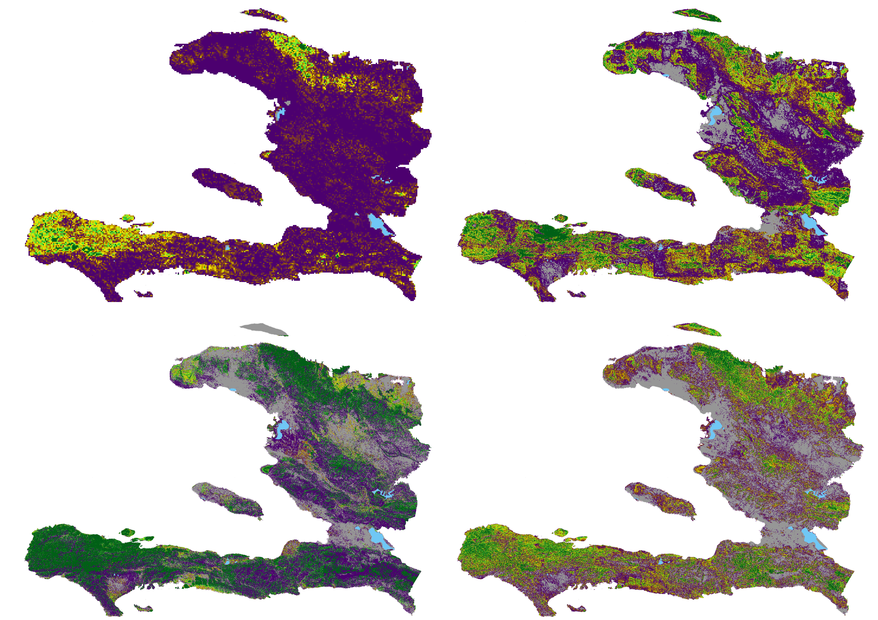
External validation
Avitabile et al. 2016
RMSE: 44 Mg/ha
Mean diff: -27.8
ESA CCI Biomass 2017
RMSE: 37 Mg/ha
Mean diff: -7.3
100 Mg/ha
60
20
Baccini et al. 2012
RMSE: 33 Mg/ha
Mean diff: -2.8
GlobBiomass
2010
RMSE: 26 Mg/ha
Mean diff: -13.9
World Bank – Charcoal in Haiti
Notes:
Now, we perform external validation, comparing our map to other similar biomass products. Note that most of the products were created for a much larger region, many the pan-tropics, so they are likely to be less accurate than our map. These are the four biomass maps for that are comparable to ours. Avitabile is coarse resolution and shows very low biomass for much of the country. Baccini lacks coverage for many areas, but where it does have data, the values are very high, large areas with greater than 100 Mg/ha. ESA Biomass has some obvious spatial inconsistencies, but in the consistent areas it indicates similar patterns and similar value ranges as what we find. GlobBiomass (Santoro et al. 2020) is currently the best alternative.

Slide 17
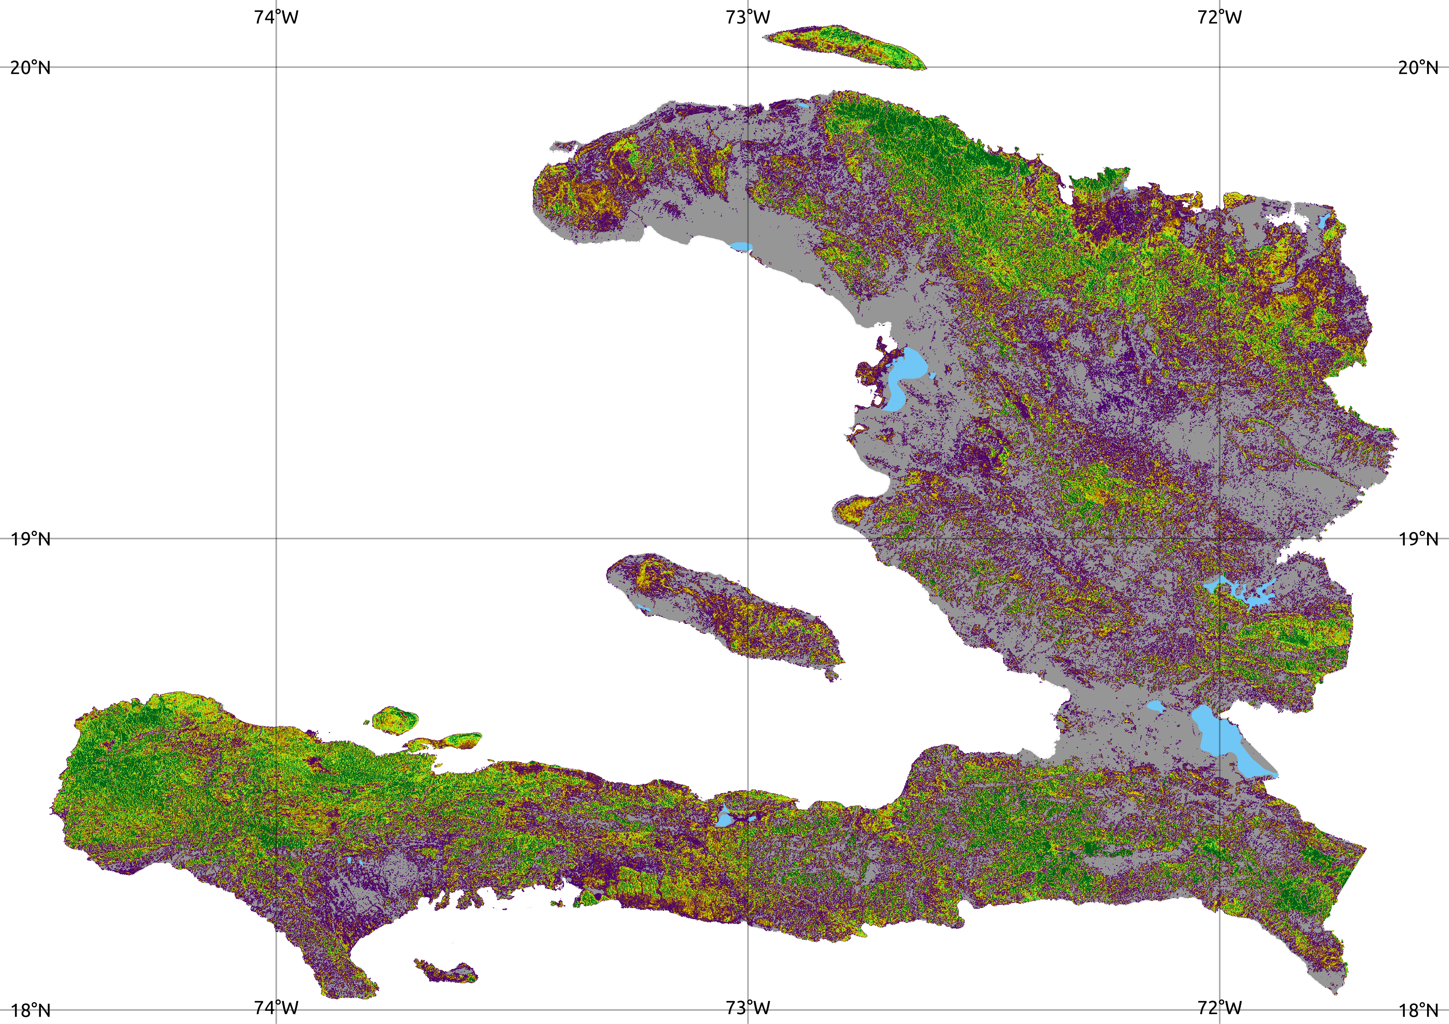
Comparison
GlobBiomass, 2010
This study, 2019
100 Mg/ha
100 Mg/ha
60
60
20
20
World Bank – Charcoal in Haiti
Notes:
Since the biomass map from GlobBiomass is the most similar and we see good agreement with our layer. Many areas are masked out of the GlobBiomass product so our map provides better coverage, but it also shows more areas in the middle biomass ranges (around 60 Mg/ha). GlobBiomass have higher values (>100) for broader extents.
Now we’ll zoom in to a few areas to continue the comparison.

Slide 18
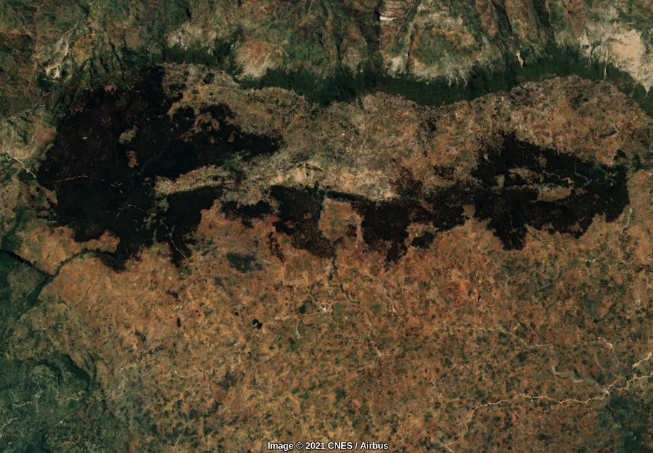
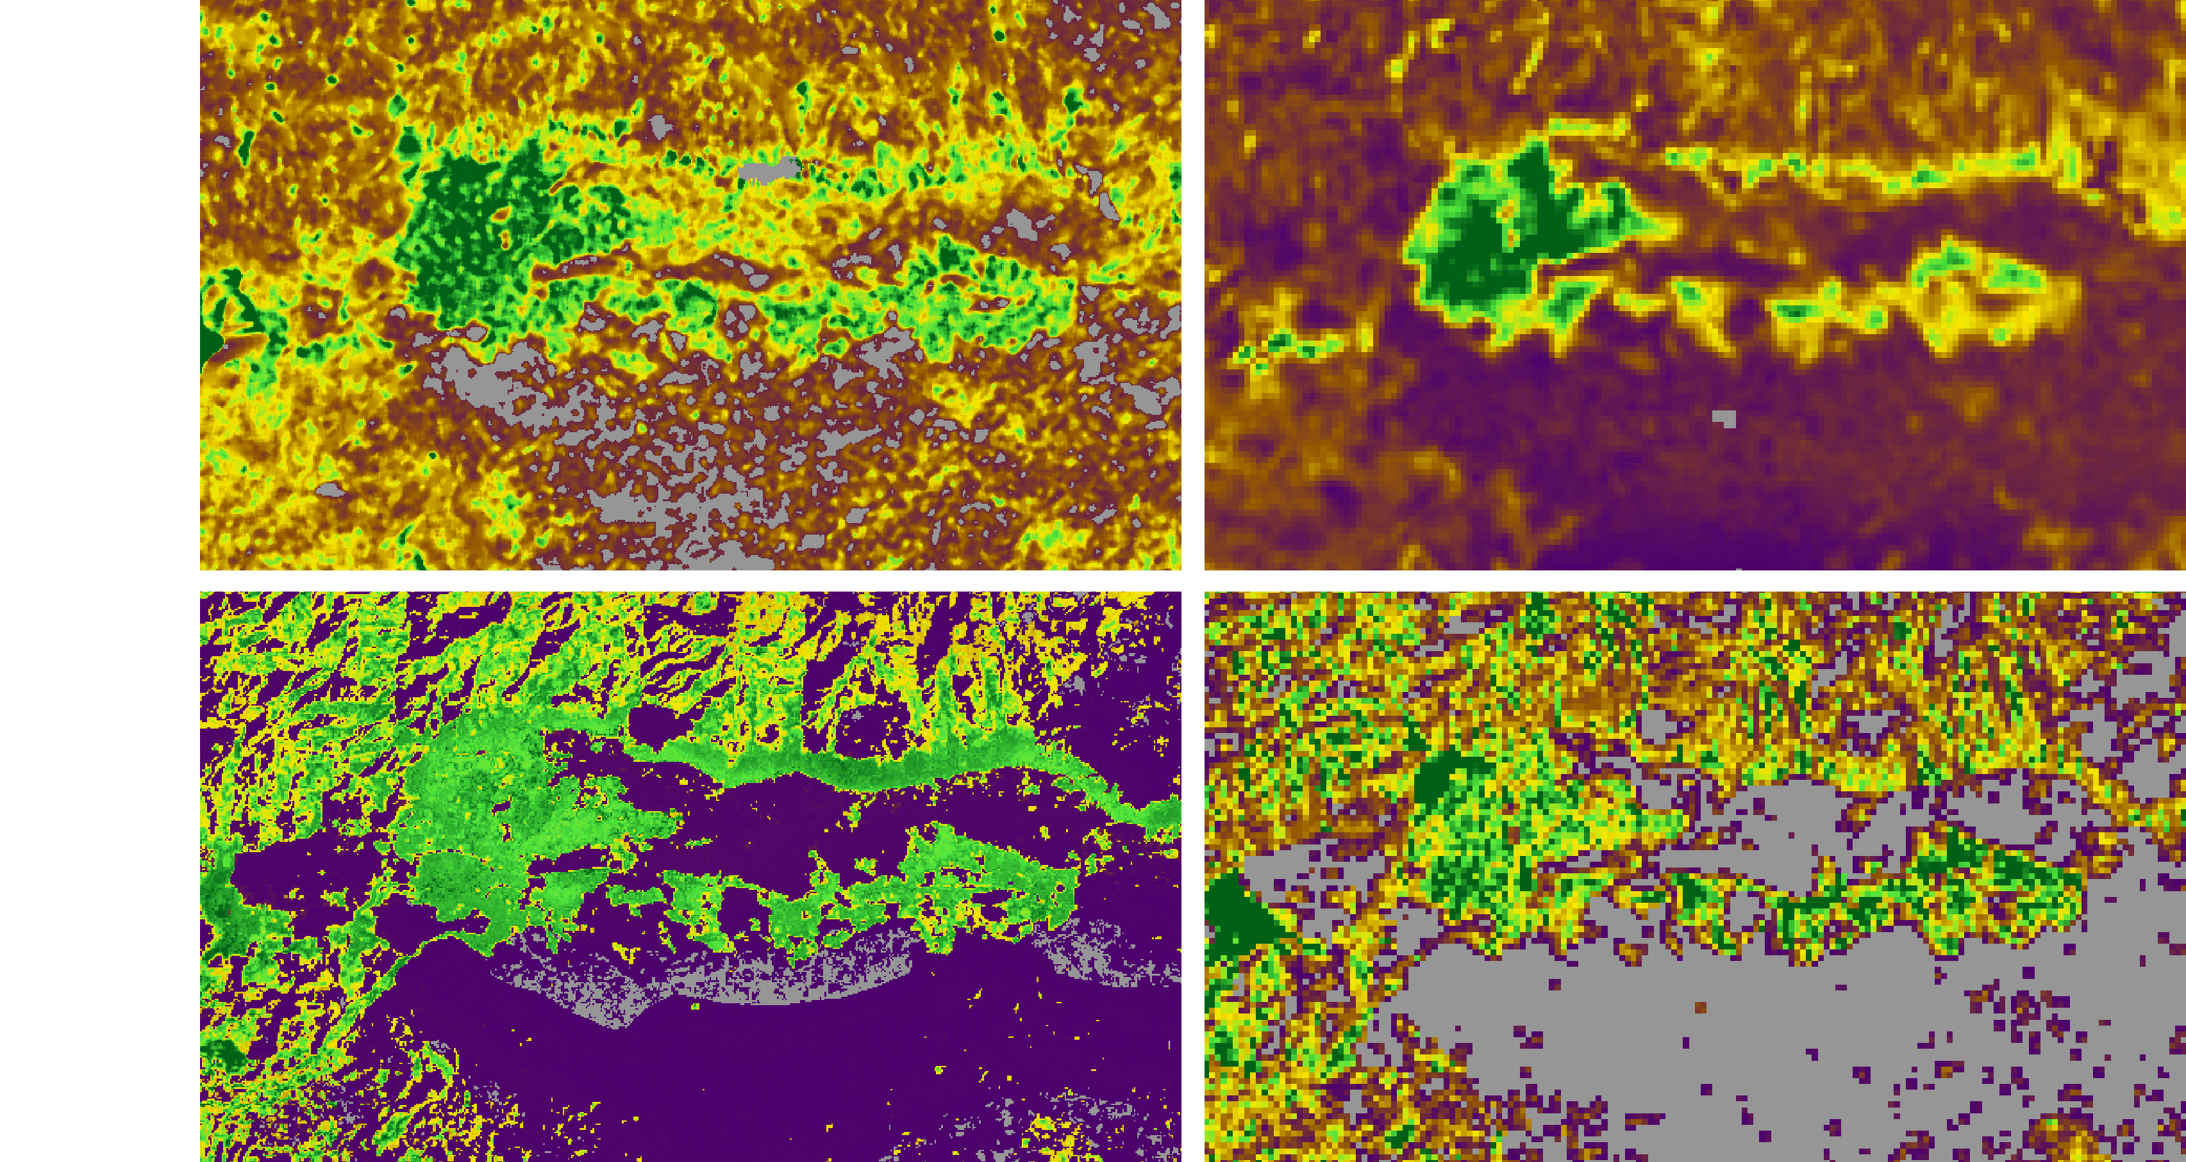
La Visite
22/6/2019
ESA
22/6/2019
This study
Baccini
GlobBiomass
200 Mg/ha
100
0
World Bank – Charcoal in Haiti
Notes:
The two areas of greatest biomass density according to experts are the conservation areas La Visite and Macaya. All products find high biomass within La Visite. Note that our map is now in the upper right corner and purple represents 0 and dark green represents 200 Mg/ha. Similar to the ESA product, we find a mostly continuous area of high biomass, around 200 Mg/ha within the core of the park and patches of high biomass in the linear forested area to the east. The GlobBiomass product is more patchy and doesn’t include data for the more sparsely vegetated area to the south and the Baccini map suggests a much more extreme pattern of no biomass in the sparser area to the south and continuous biomass of about 150 Mg/ha in the park.
I’ll give you a moment to look at these side-by-side maps.

Slide 19
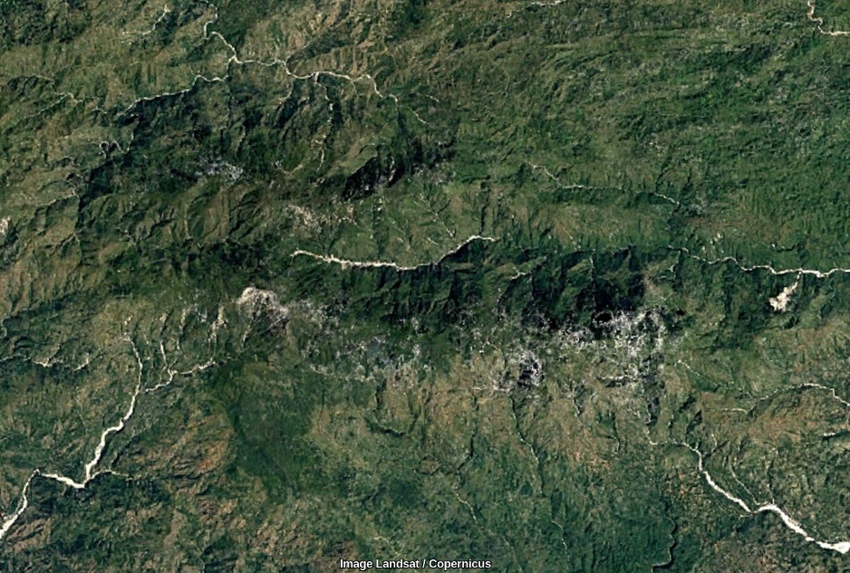
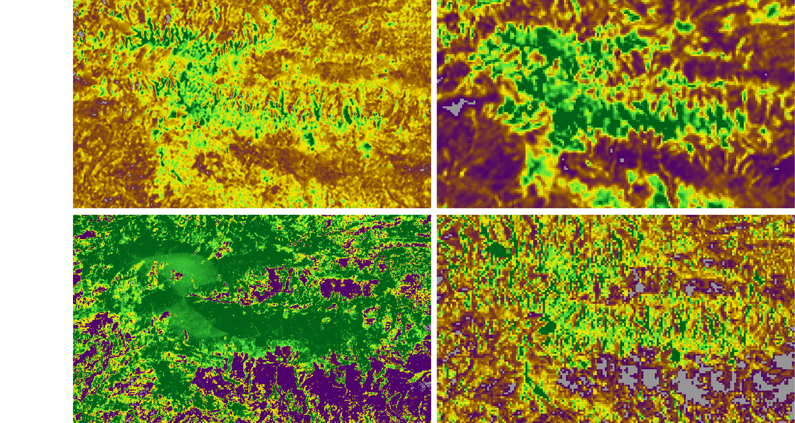
Macaya
22/6/2019
This study
ESA
12/2018
Baccini
GlobBiomass
200 Mg/ha
100
0
World Bank – Charcoal in Haiti
Notes:
Macaya is another area that’s very difficult to map because of the strong topography, many steep slopes confound radar signals. As you can see for this are, our map is very similar to the GlobBiomass product, with biomass of 100-200 in the main forested areas and values around 60 Mg/ha on the surrounding slopes. ESA shows more contiguous areas of high biomass within the park and Baccini shows a broader extent with even higher biomass.

Slide 20
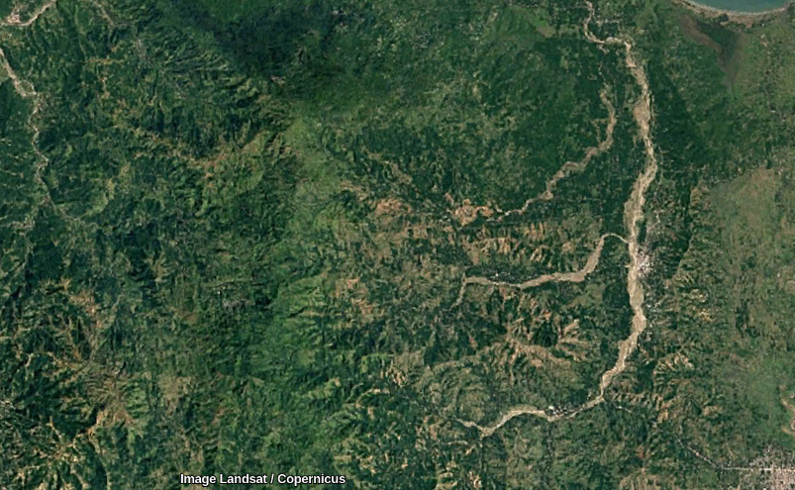
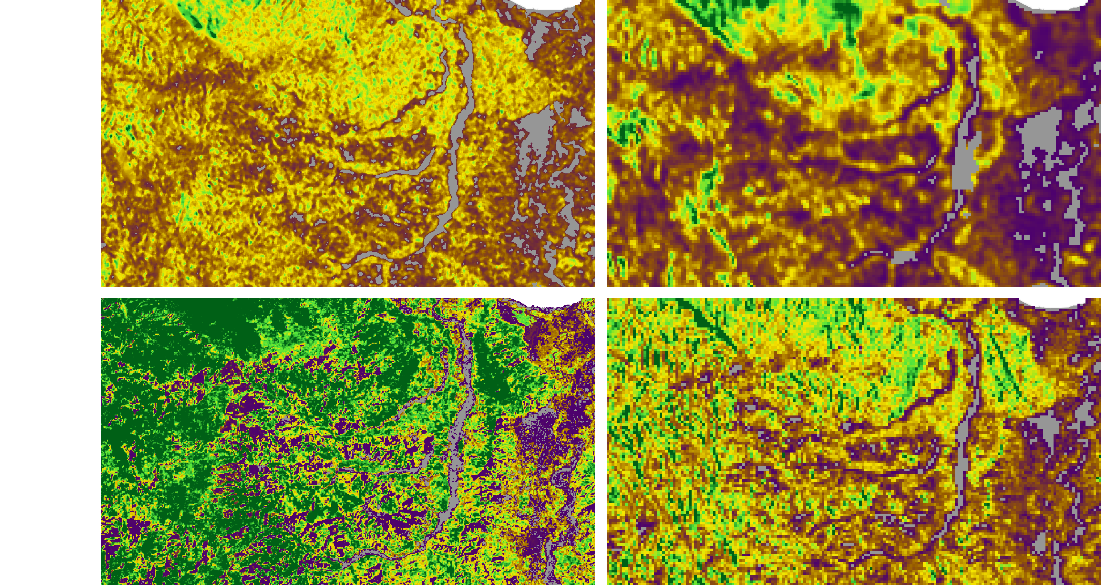
Port-Margot
12/2018
This study
ESA
Baccini
GlobBiomass
200 Mg/ha
100
0
World Bank – Charcoal in Haiti
Notes:
Another interesting area is in the north, in the Port-Margot region. Here our map indicates less backscatter than the other products in the most forested areas. However, it indicates more area with mid-level biomass.
I’ll be interested to hear your thoughts on the accuracy of these patterns during the time for questions.

Slide 21
Compare findings
Our findings
82% (2.2 million hectares) of Haiti has AGB > 20 Mg/ha, which is sometimes used as the threshold to identify tree cover (Ryan, personal communication).
The above-ground biomass stock totals 122 million Mg (only considering areas with AGB > 20 Mg/ha).
Average AGB for “tree cover” in the 2017 classification is 60 Mg/ha (for 954,000 ha). This amounts to 56 million Mg of biomass in forested areas.
Previous findings
The majority of estimates are 20-40% (Churches et al., 2014)
Estimates of the total above-ground biomass stock range from 12 – 232 million Mg.
FRA: ~12 million
Global Forest Watch: ~106 million
Baccini: ~232 million
GlobBiomass indicates an average forest-area AGB of 73 Mg/ha, but also identified fewer forested areas (532,000 ha).
World Bank – Charcoal in Haiti
Notes:
Another external validation is to compare our findings of overall biomass with those previously reported. On the left, I present our findings compared to the equivalent metrics from other sources on the right.
According to our map, 82% of the country has greater than 20 Mg/ha biomass density, which is sometimes used as the threshold to identify tree cover. This is much more than the 20-40% reported elsewhere. However, I believe that it indicates a difference in the threshold used to identify tree cover rather than an inaccuracy in our map.
We calculate a total above-ground biomass stock of 122 million Mg. Previous findings have a very wide range of estimates. Ours is about in the middle. We find much more biomass than the FAO’s forest resource assessment for the year 2010 and much less than would be estimated by Baccini’s biomass map. Our findings are very similar to the biomass reported by Global Forest Watch based on maps by Hansen.
When we look only at the areas classified as tree cover in Richard’s land cover map, we find an average AGB of 60 Mg/ha for tree covered areas. This is less than the average reported by GlobBiomass, but also GlobBiomass appears to have a more limited definition of forest as it identifies only 530 thousand forested hectares, which is half of the area covered by the tree cover class in our map.

Slide 22
Conclusions
We produce a high-resolution map of above-ground biomass for Haiti and Hispaniola that can be used to evaluate spatial and temporal patterns of forest stock.
Based on the available data, we find high accuracy (RMSE: ~20 Mg/ha).
Haiti has a total AGB stock of 122 million Mg, much greater than that estimated by the FRA and about the same as that estimated by Global Forest Watch.
Future work should include collection of more in situ data for model calibration and validation.
World Bank – Charcoal in Haiti
Notes:
In conclusion, we successfully produce a high-resolution map of above-ground biomass for Haiti and the rest of the island that can be used to evaluate spatial and temporal patterns of forest stock. Our biomass estimates have an overall uncertainty measured in root mean squared error of 20 Mg/ha of biomass. We calculate that Haiti holds 122 million Mg of above-ground biomass, much greater than that estimated by the FRA and about the same as that reported by Global Forest Watch.
To improve upon this work in the future, we would like to incorporate more ground measurements of AGB to calibrate the model.

Slide 23
Thank you
World Bank – Charcoal in Haiti
Notes:
Thank you so much for your attention. I’d love to hear your thoughts.

Slide 24
Extra Slides
World Bank – Charcoal in Haiti

Slide 25
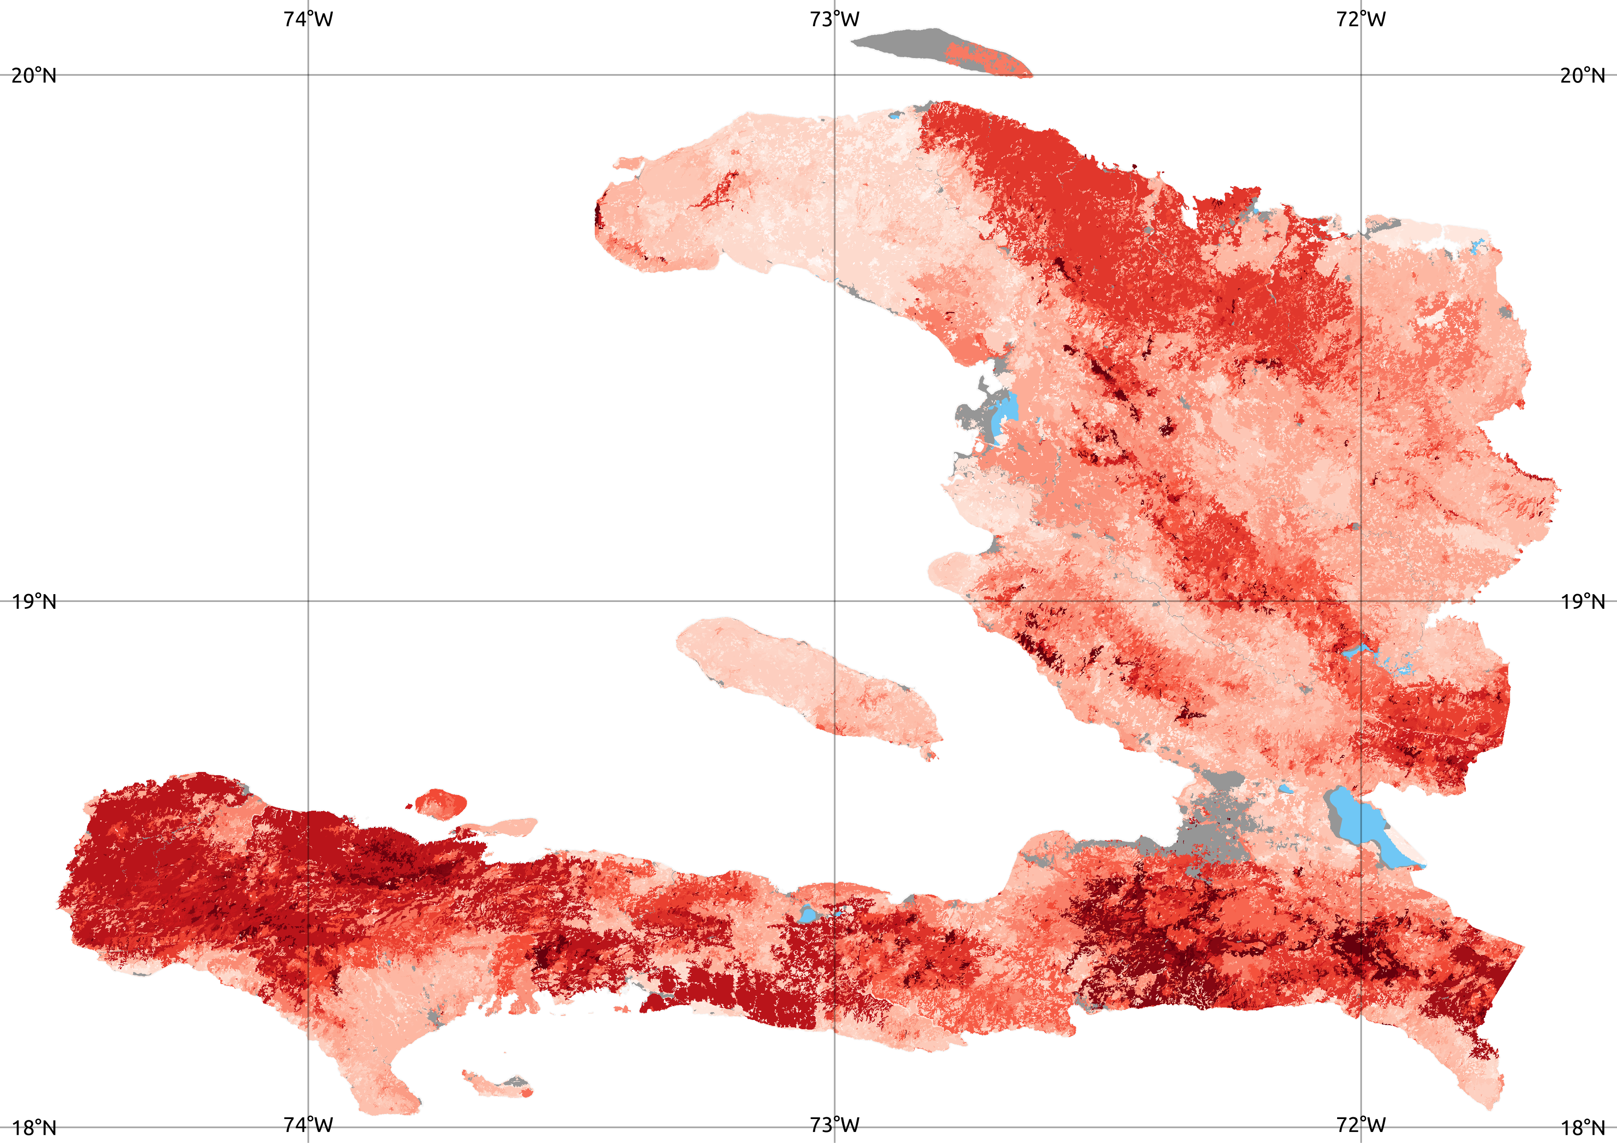
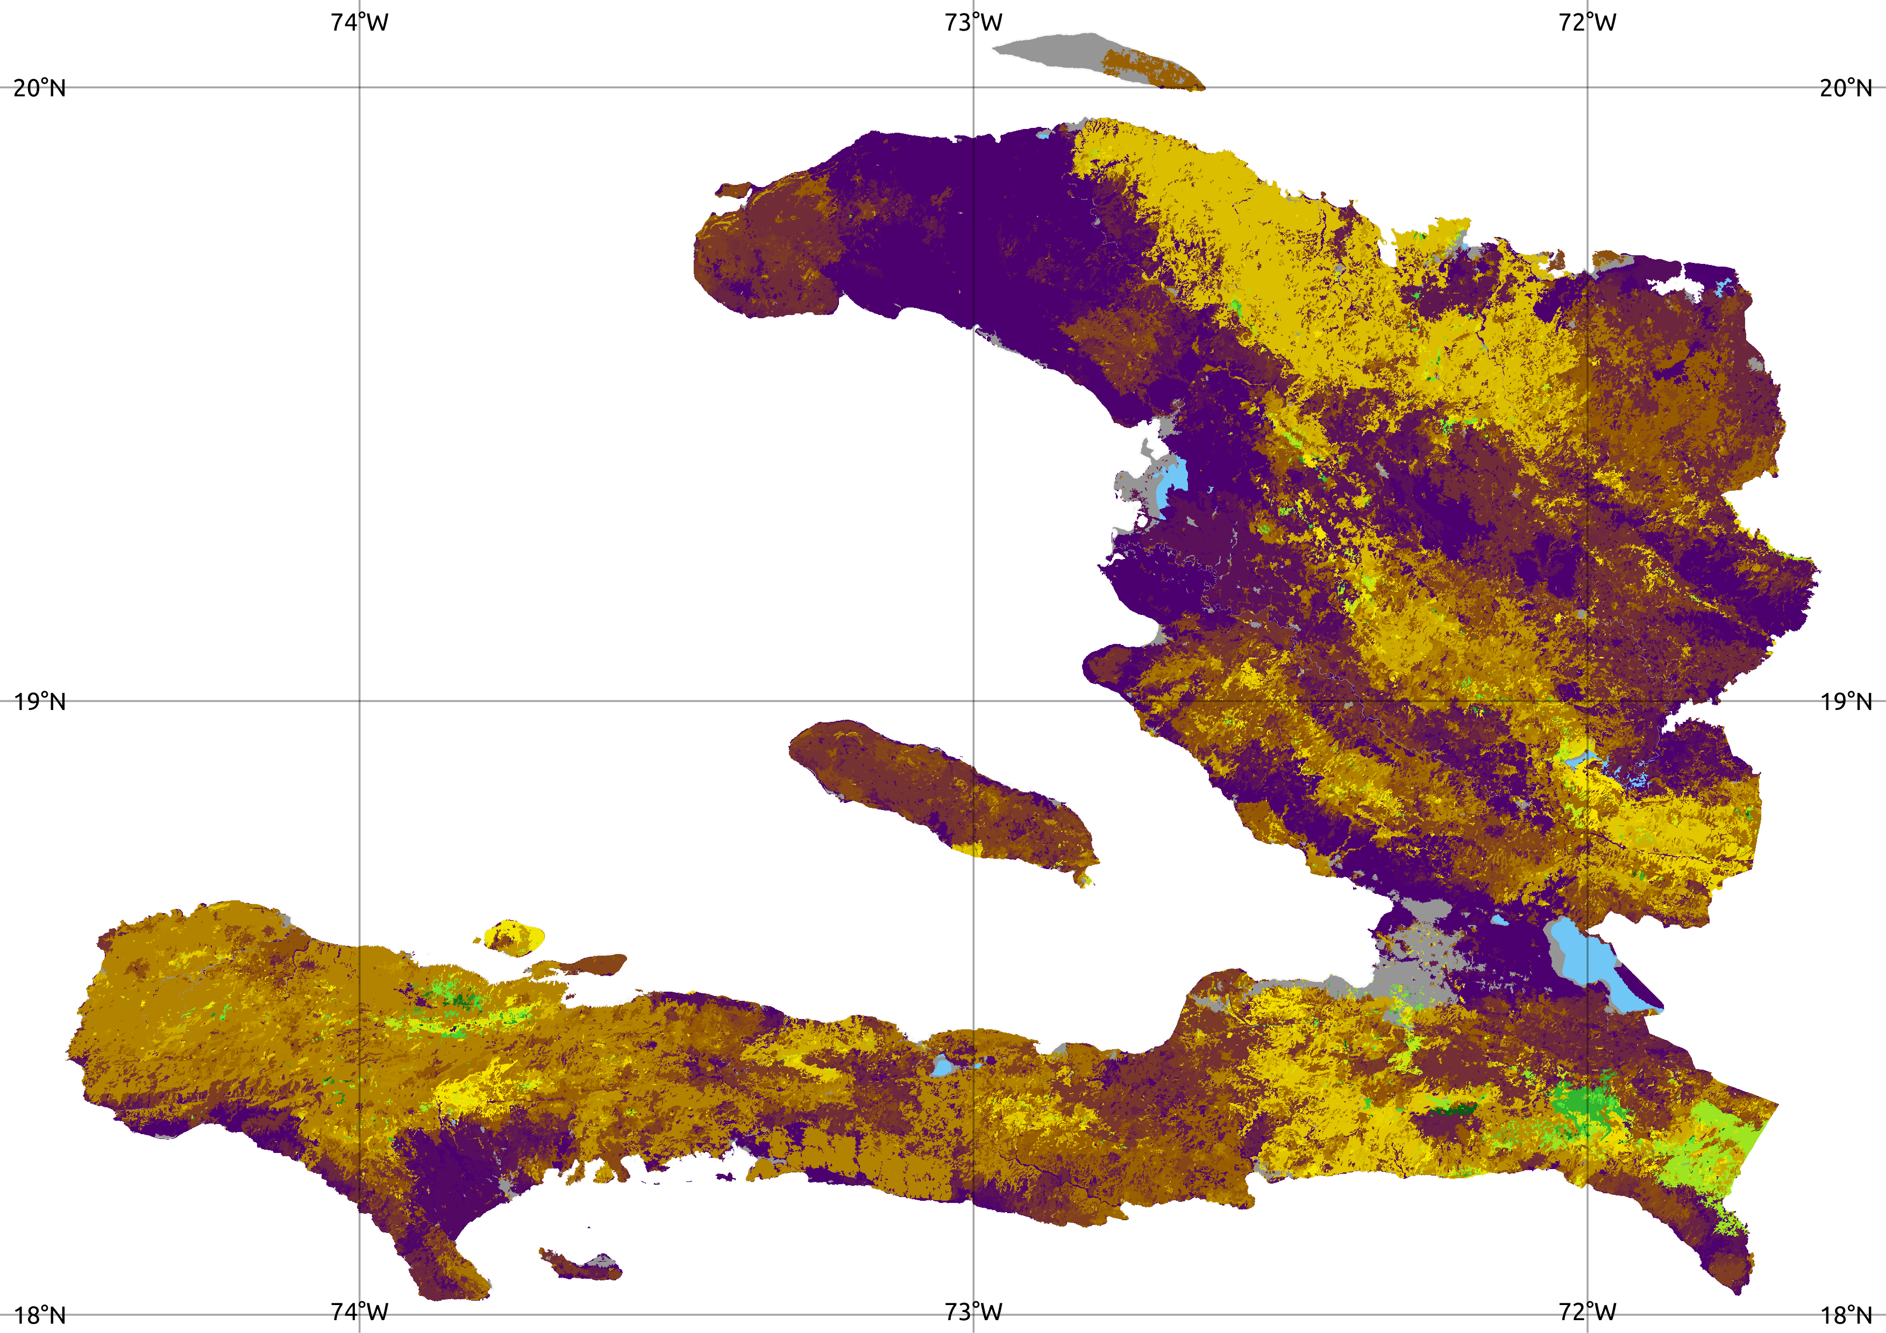
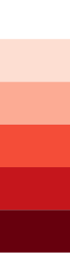
Uncertainty
Standard deviation of AGB by land cover patches
50 Mg/ha
30
0
World Bank – Charcoal in Haiti

Slide 26
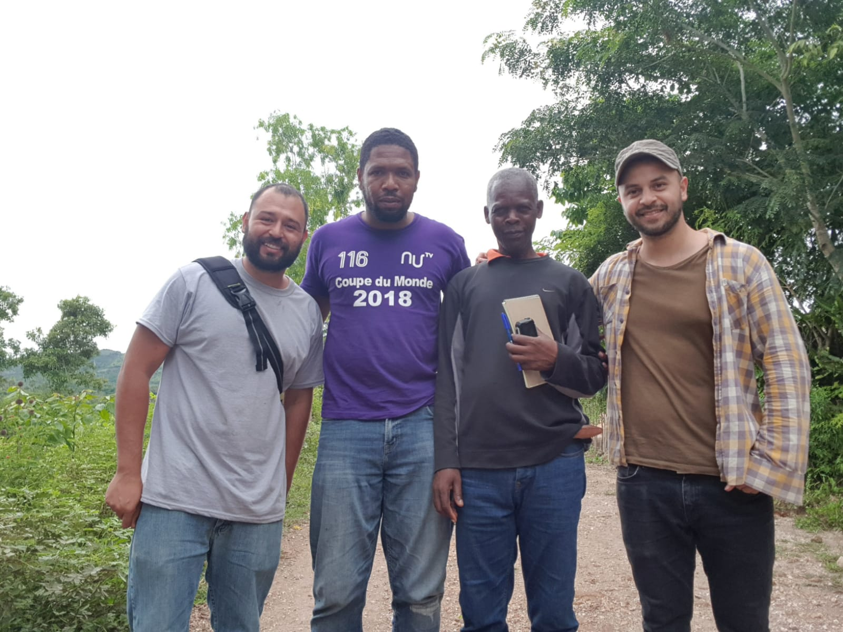

Slide 27
Field work
World Bank – Charcoal in Haiti

